Slide 1
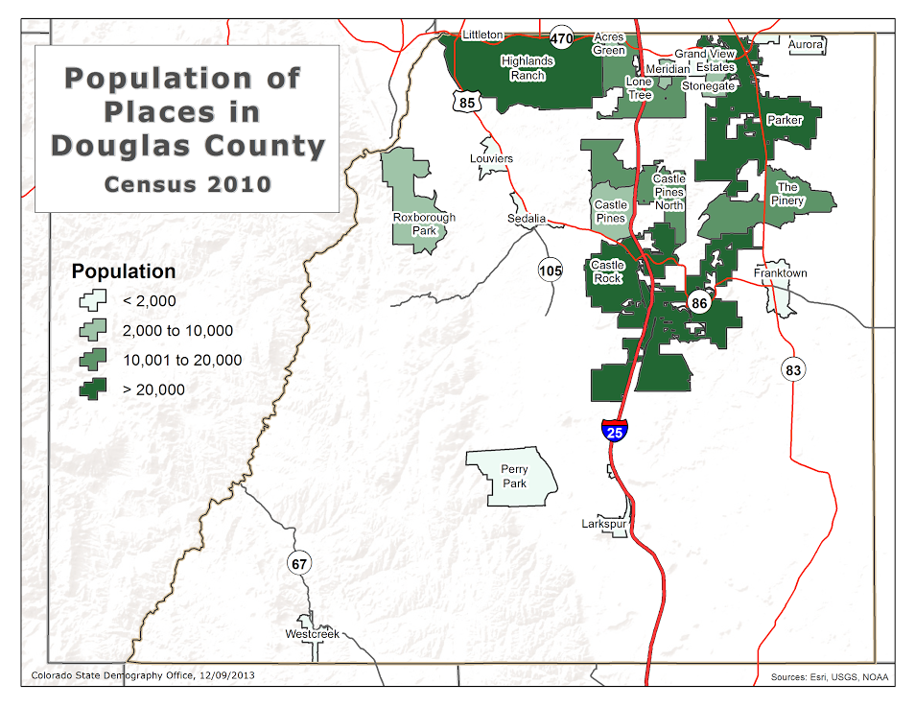
Demographics of Castle Rock and Douglas County

Slide 2
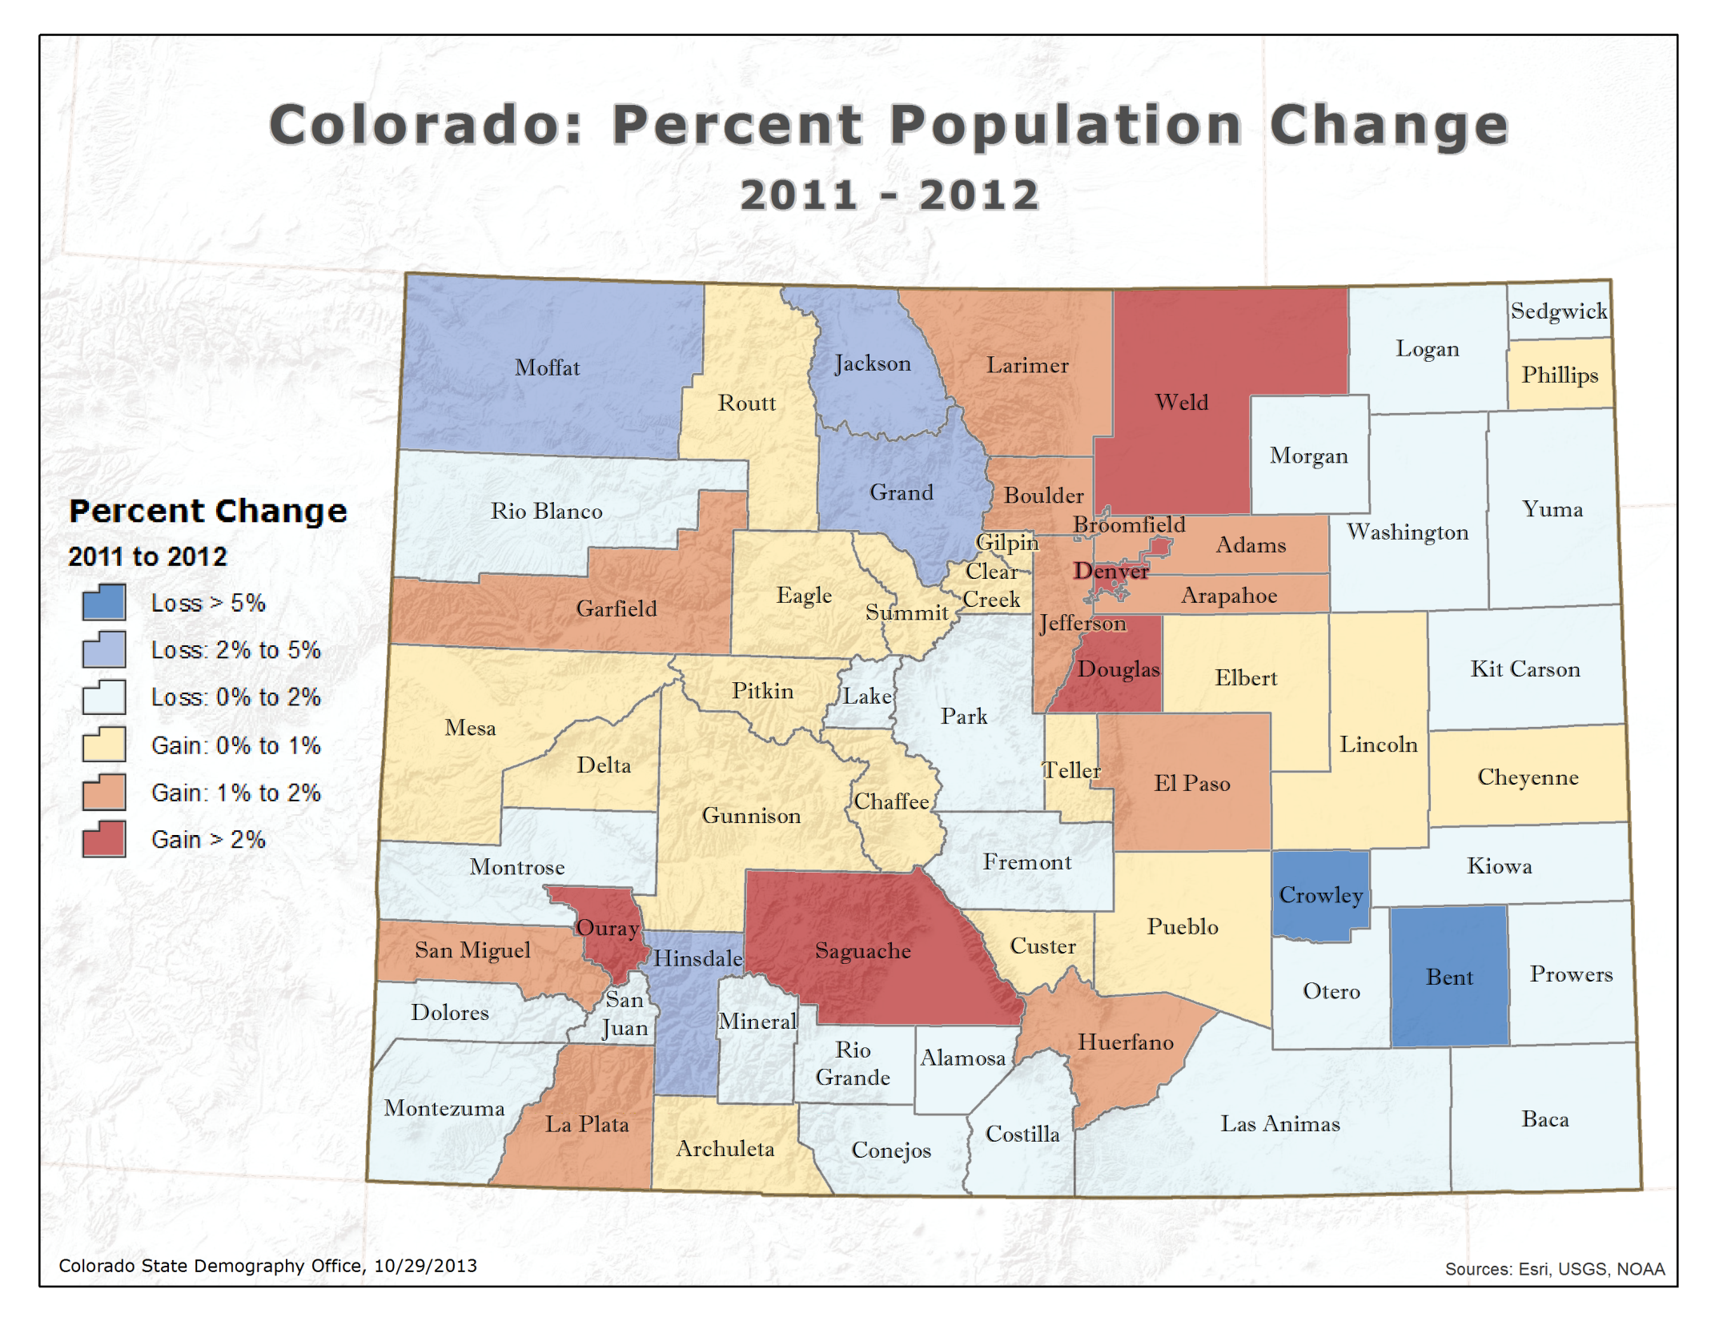
Notes:
Colorado increase of 70157
Douglas increase of 5800
Castle Rock increase of 1,000
Castle Rock – 50,811
Douglas – 298,167

Slide 3
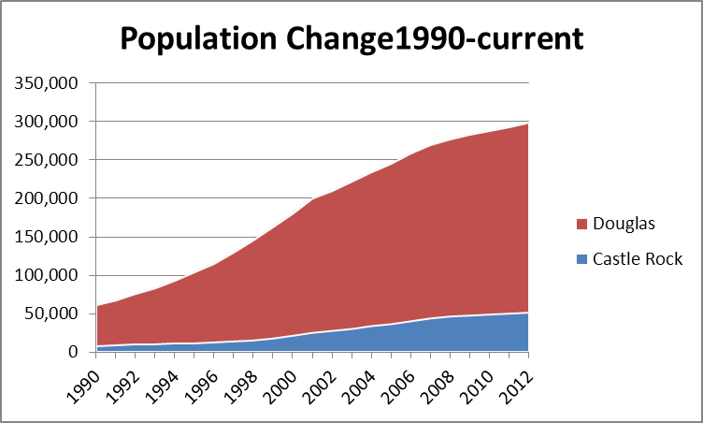

Slide 4
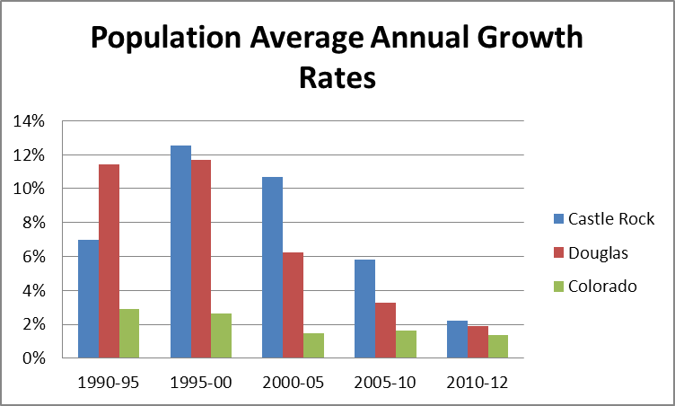

Slide 5
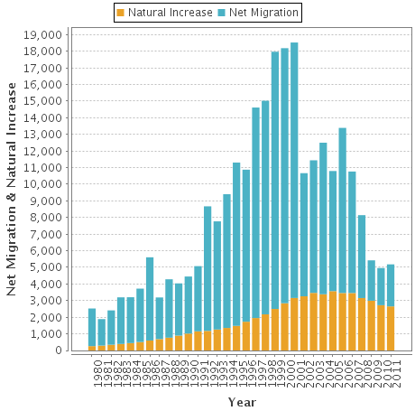
Douglas Components of Population Change

Slide 6
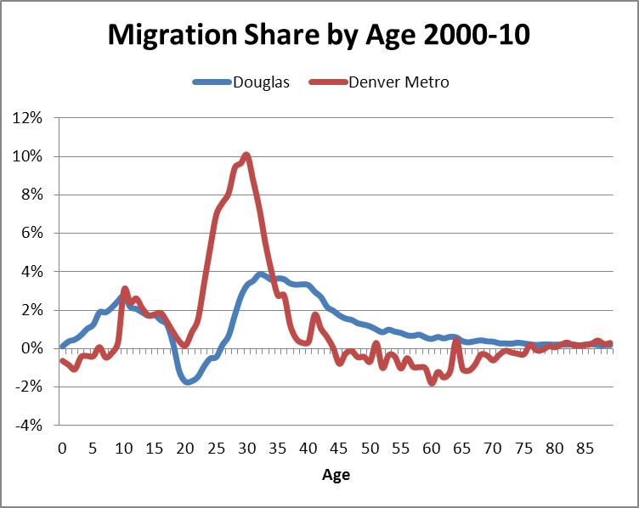

Slide 7
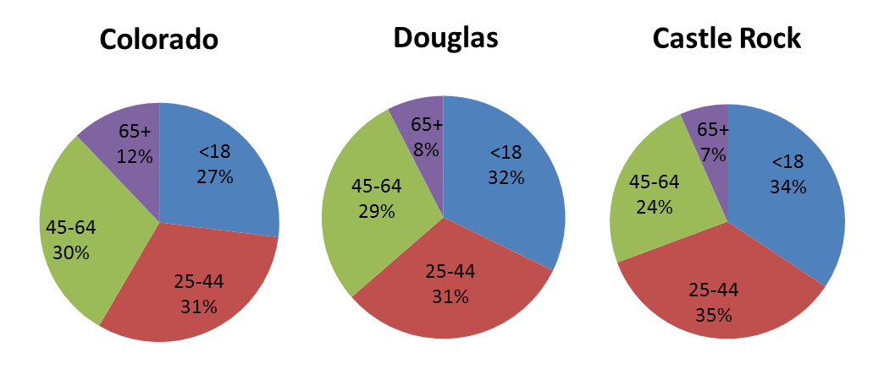
Population by Age

Slide 8
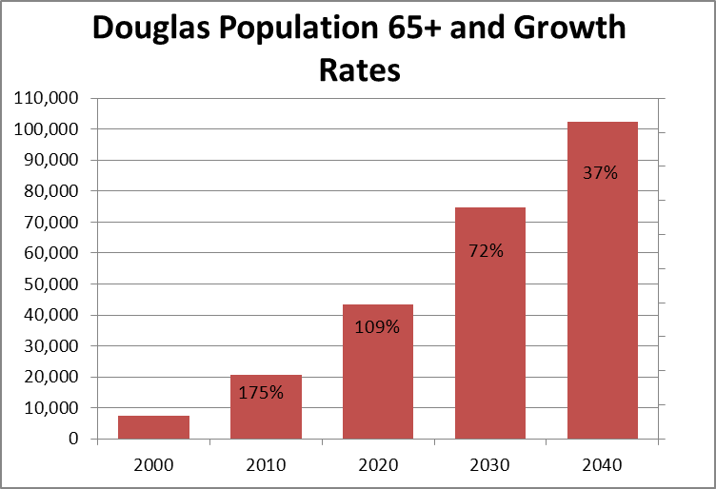

Slide 9
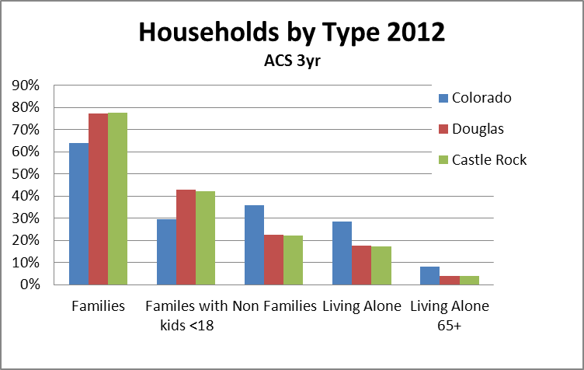

Slide 10
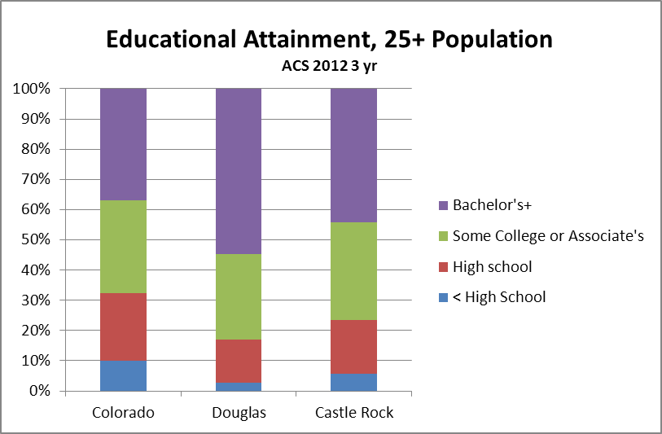

Slide 11
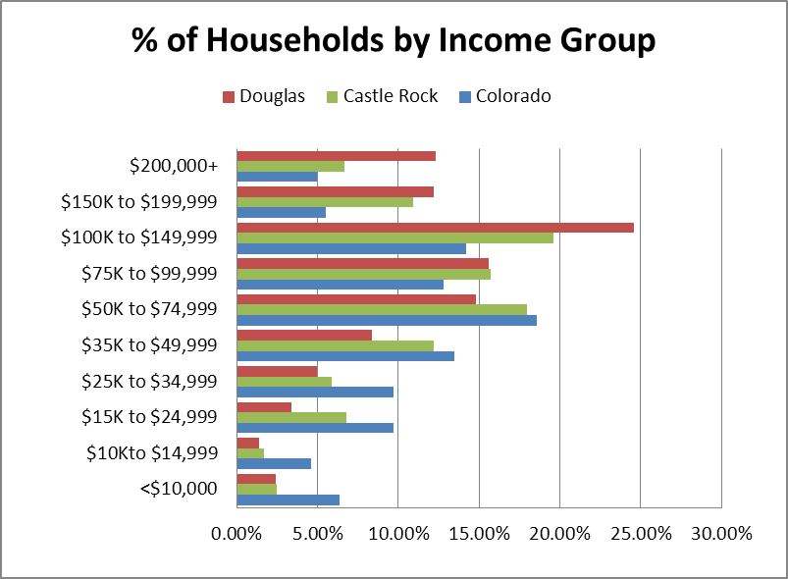

Slide 12
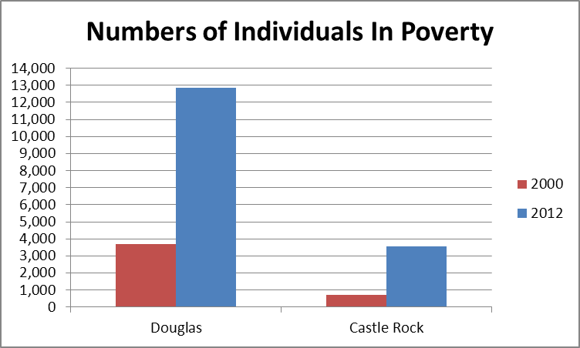

Slide 13
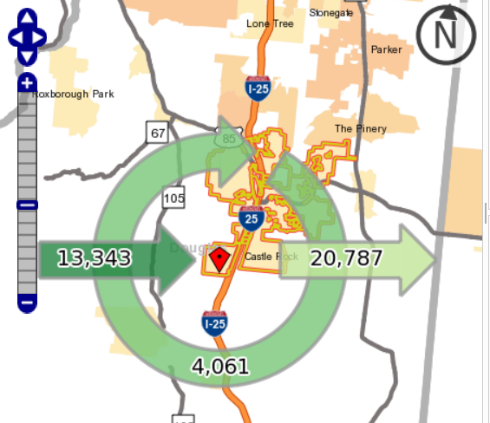
Commuting in Castle Rock

Slide 14
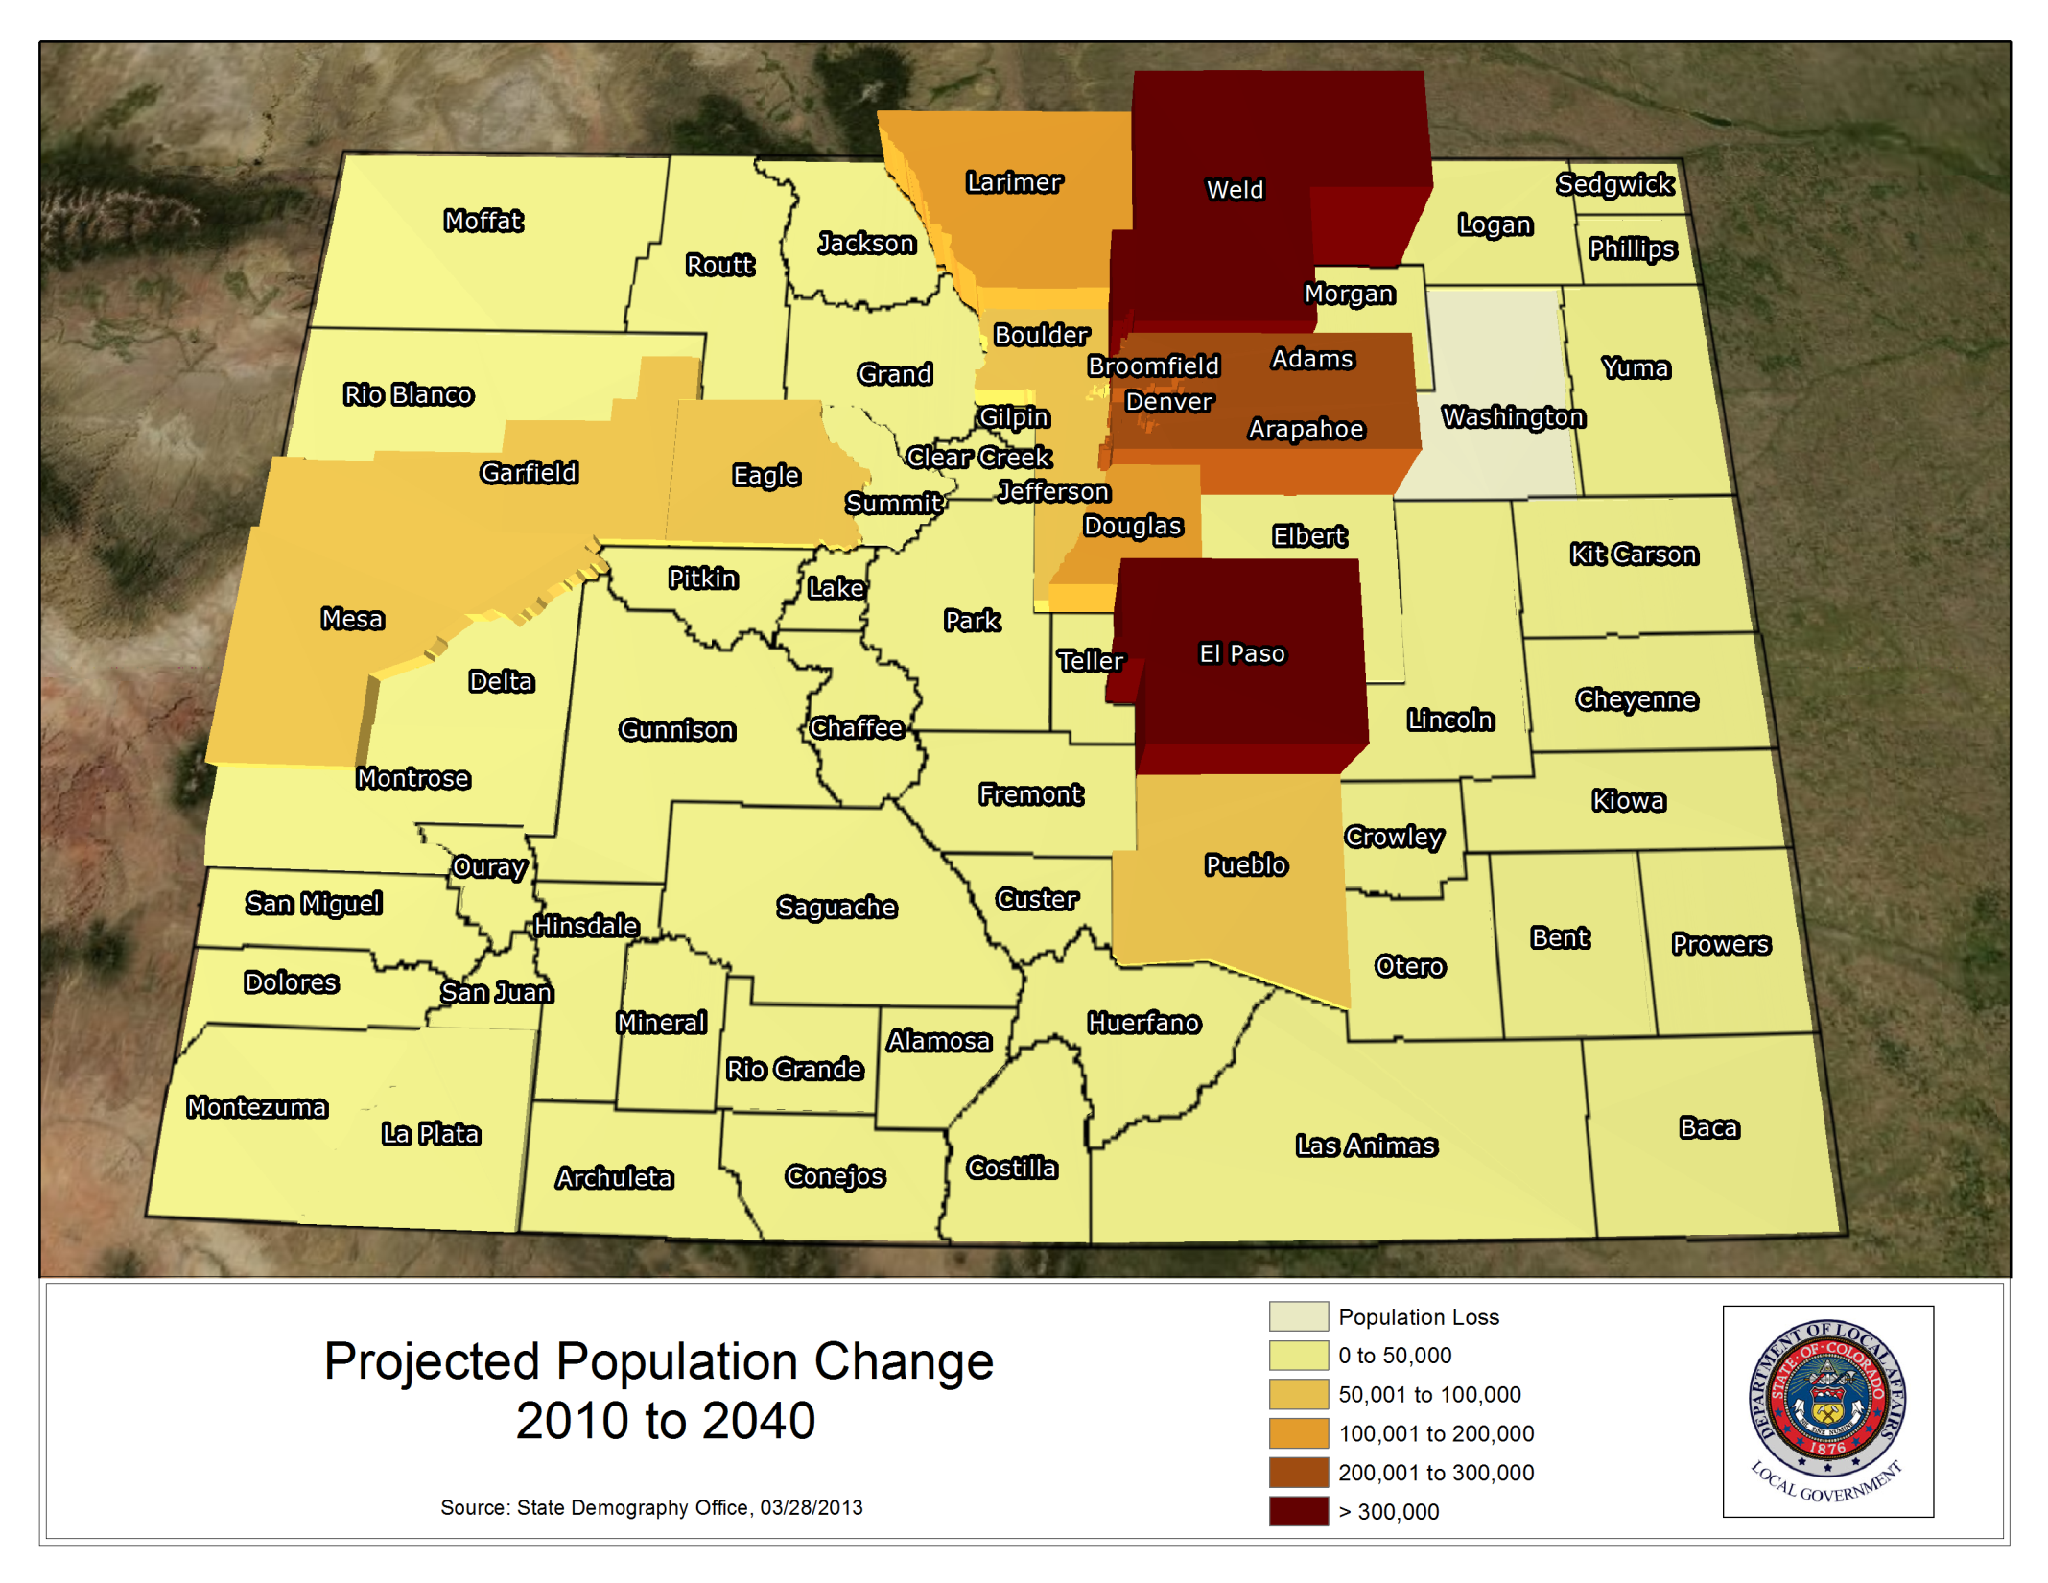

Slide 15
Population Forecasts

Slide 16
Thank You!
Contact:
Elizabeth Garner
State Demographer
Elizabeth.garner@state.co.us
303-866-3096
303-864-7750 – NEW AS OF DEC 12th

